Slide 1

Relational model
Lecture 2

Slide 2

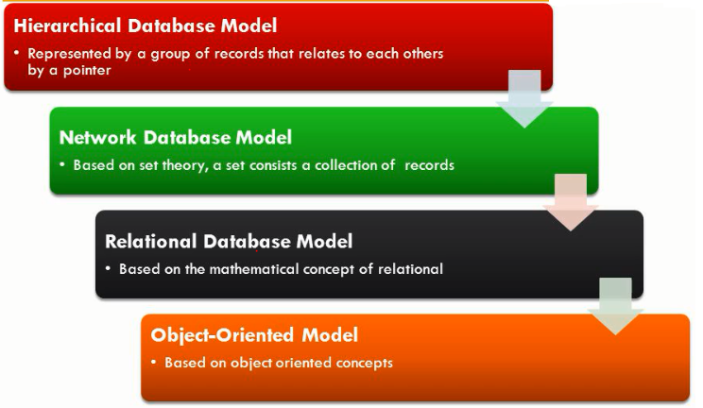



Types of Database Model

Slide 3
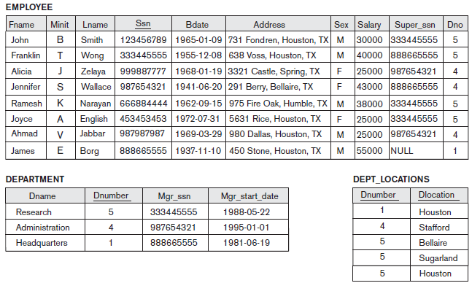
Populated database state for COMPANY

Slide 4
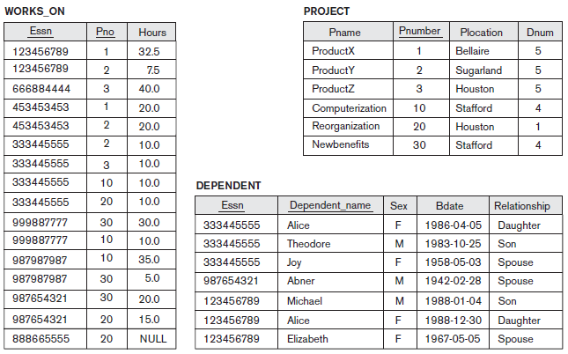
Populated database state for COMPANY

Slide 5
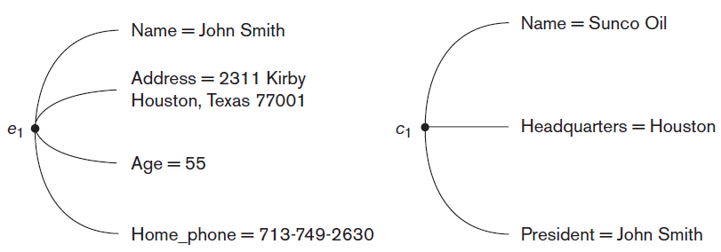
Entities and Attributes
Two entities, EMPLOYEE e1 and
COMPANY c1 and their attributes
Notes:
entity is a real-world object

Slide 6

Entities and Attributes Example

Slide 7

Attribute
Attribute
Each attribute of a relation has a name
Set of allowed values for each attribute is called the domain
Attribute values are (normally) required to be atomic
The special value null is a member of every domain

Slide 8
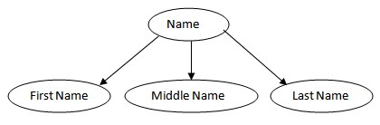
Simple vs Composite Attribute
Simple Attributes are atomic values, which cannot be divided further.
Composite Attributes are made of more than one simple attribute.
Ssn

Slide 9

Relation Schema
Relation schema R
Denoted by R(A₁, A₂, ...,A_{n})
Made up of a relation name R and a list of attributes, A₁, A₂, ..., A_{n}
Schema of a relation consists of
attribute definitions
name
type/domain
integrity constraints

Slide 10
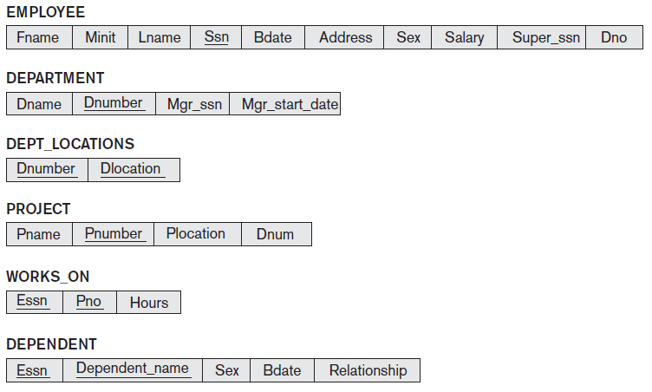
Relational Schema - COMPANY Database

Slide 11
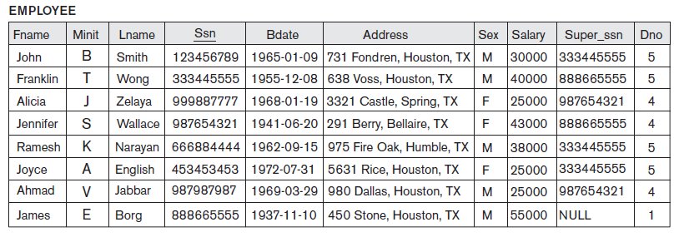
Relational Instance
The current values (relation instance) of a relation are specified by a table
An element t of r is a tuple, represented by a row in a table
Order of tuples is irrelevant (tuples may be stored in an arbitrary order)
Tuples

Slide 12

Database And Relations
A database consists of multiple relations
Information about company is broken up into parts, with each relation storing one part of the information
E.g. Employee: information about employee and their department Department: information about department Dept_locations: information about department locations.

Slide 13

Why Split Information Across Relations?
Storing all information as a single relation such as
Company(Employee, Department, Department_Loc, ..)
results in
repetition of information
the need for null values
Normalization deals with the
designing of relational schemas.

Slide 14

Keys
KEY
Foreign
Candidate
Alternate
Primary
Superkey

Slide 15

Candidate Key
It must contain unique values
Candidate key may have multiple attributes
It should contain minimum fields to ensure uniqueness
Uniquely identify each record in a table
Eg. Ssn : Candidate Key
Ssn, Ename: Not Candidate Key

Slide 16
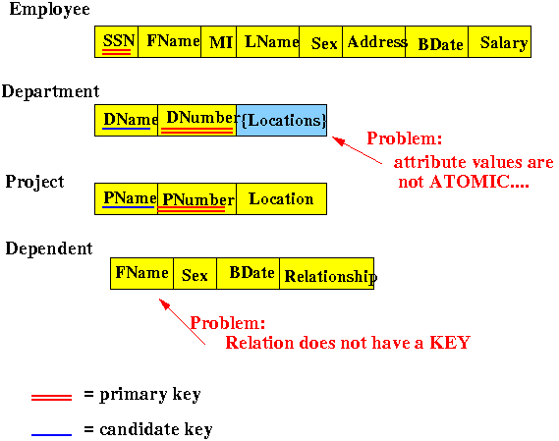
Candidate Key Example
SSN and Dname can be considered as candidate keys

Slide 17

Candidate Key Drill
In the given table which columns can be considered as candidate keys which help us to uniquely identify the student record in the table?
StudID | Roll No | FirstName | LastName | Email
1 | 11 | Tom | Price | abc@gmail.com
2 | 12 | Nick | Wright | xyz@gmail.com
3 | 13 | Dana | Natan | mno@yahoo.com

Slide 18

Key Constraints

Slide 19
Simple Vs Composite Candidate Key
Ssn: Simple Key
Fname, Minit, Lname: Composite Key
Fname, Address ????

Slide 20
Prime vs Non-prime Attribute
Relation R Attributes
Prime Attributes
Non-prime Attributes
Belonging to Candidate Keys
Not belonging to Candidate Keys

Slide 21

Primary Key
Two rows can't have the same primary key value
The primary key field cannot be null.
The value in a primary key column can never be modified or updated if any foreign key refers to that primary key.
Atmost one primary key for any relation.
i.e. any candidate key whose values are always NOT NULL.
Eg. Ssn: Primary Key (no null value allowed)

Slide 22
Primary Key Drill
Identify Primary Key??

Slide 23

Alternate Key
All candidate keys except primary keys.
Allows NULL value
More than 1 alternate key possible
Eg. { Ename, Address, Bdate }

Slide 24
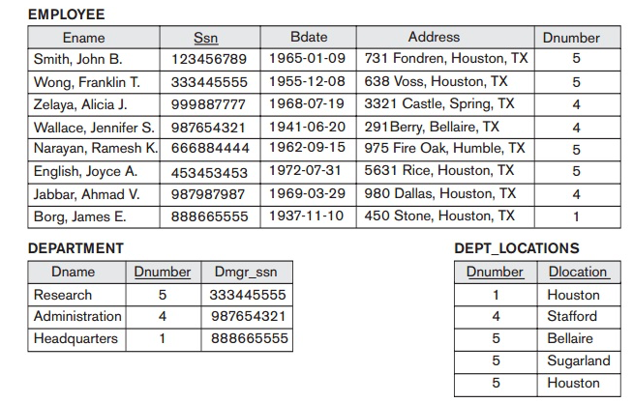
Alternate Key Example
Dnumber and Dname are qualified to become a primary key in DEPARTMENT relation. But since Dnumber are the primary key, DName becomes the alternate key.

Slide 25

Alternate Key Drill
Identify the candidate, primary and alternate
key in the following SCHOOL Database.
StudID | Roll No | FirstName | LastName | Email
1 | 11 | Tom | Price | abc@gmail.com
2 | 12 | Nick | Wright | xyz@gmail.com
3 | 13 | Dana | Natan | mno@yahoo.com

Slide 26
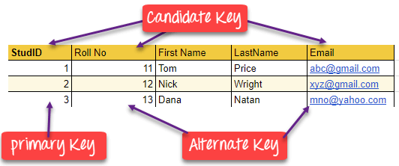
Solution - Alternate Key Drill

Slide 27

SuperKey
A superkey is a group of single or multiple keys which identifies rows in a table. A Super key may have additional attributes that are not needed for unique identification.
Eg. (EmpSSN, Empname) and (EmpNum, Empname) are superkeys.
EmpSSN | EmpNum | Empname
9812345098 | AB05 | Shown
9876512345 | AB06 | Roslyn
199937890 | AB07 | James

Slide 28
Primary, Candidate and Super Key
Minimal SuperKey
Set of attributes that uniquely identifies records
Candidate key with NO NULL values

Slide 29

Foreign Key
A foreign key is a set of attributes to create a relationship with another relation.
Foreign keys help us to maintain data integrity and also allows navigation between two
different instances of an entity.

Slide 30
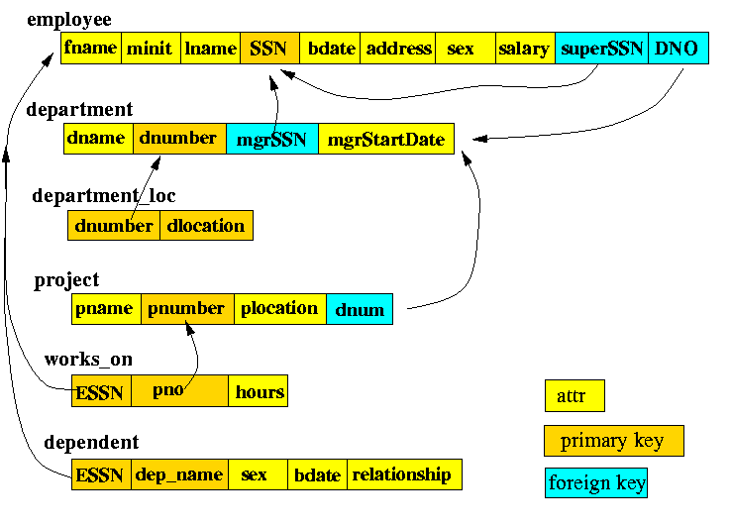
Foreign Key Example

Slide 31
Foreign Key Drill
Identify the primary and foreign key in the following SCHOOL database.
DeptCode | DeptName
001 | Science
002 | English
005 | Computer
Teacher ID | Fname | Lname
B002 | David | Warner
B017 | Sara | Joseph
B009 | Mike | Brunton

Slide 32

Solution - Foreign Key Drill
In this table, adding the foreign key in Deptcode to the Teacher name, creates a relationship between the two tables.
This concept is also known as Referential Integrity.
Teacher ID | DeptCode | Fname | Lname
B002 | 002 | David | Warner
B017 | 002 | Sara | Joseph
B009 | 001 | Mike | Brunton

Slide 33
Integrity Constraints

Slide 34
Referential Integrity Constraint
Referenced Relation
Referencing
Relation

Slide 35
Referential Integrity Constraint (Cont.)
Tuples in the referencing relation R1 have attributes FK (called foreign key attributes) that reference the primary key attributes PK of the referenced relation R2.
A tuple t1 in R1 is said to reference a tuple t2 in R2 if t1[FK] = t2[PK].
The value in the foreign key column (or columns) i.e. FK of the the referencing relation R1 can be either:
a value of an existing primary key value of a corresponding primary key PK in the referenced relation R2,
or
a null.
R2
R1
……. | ……. | ……. | ……. | PK
……. | ……. | FK

Slide 36

Referential Integrity Constraints
Referential integrity also includes the rules that dictate what types of data manipulation are allowed on referenced values and how these actions affect dependent values.

Slide 37
Referential Integrity Constraints
Referential Integrity Constraint
Referenced Relation
( DEPT )
Insertion
Deletion
Referencing Relation
( EMP )
Insertion
Updation
Deletion
Updation
No Violation
● ON DELETE, NO ACTION
● ON DELETE, CASCADE
● ON DELETE, SET NULL
● ON UPDATE, NO ACTION
● ON UPDATE, CASCADE
● ON UPDATE, SET NULL
Restricted
No Violation
Restricted

Slide 38
Referential Integrity Constraint - INSERTION
Insertion in Referenced Relation is allowed
Insertion in Referencing Relation is restricted

Slide 39
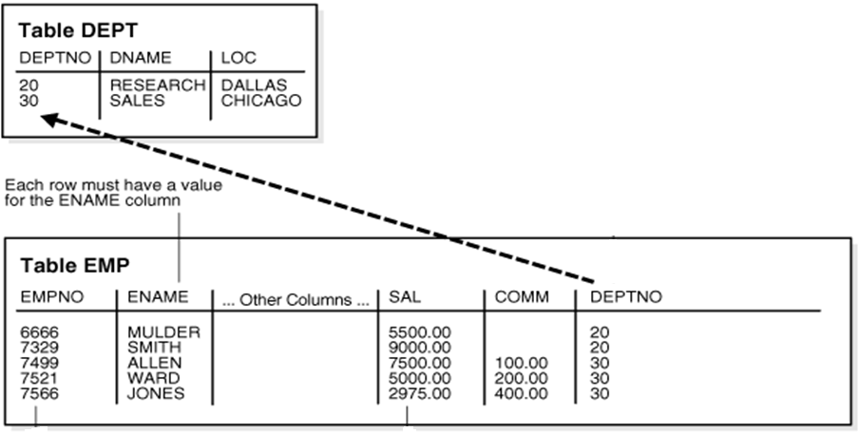
Deletion/Updation in Referenced Relation
ON DELETE, CASCADE
ON UPDATE, CASCADE

Slide 40
Deletion/Updation in Referenced Relation
ON DELETE, SET NULL
ON UPDATE, SET NULL

Slide 41
Deletion/Updation in Referenced Relation
ON DELETE, NO ACTION
ON UPDATE, NO ACTION

Slide 42

Deletion in Referencing Relation

Slide 43
Updation in Referencing Relation

Slide 44
Primary key vs Foreign Key
Primary Key
Helps you to uniquely identify a record in the table.
Foreign Key
It is a field in the table that is the primary key of another table.
Primary Key never accept null values.
Primary key is a clustered index and data in the DBMS table are physically organized in the sequence of the clustered index.
You can have the single Primary key in a table.
A foreign key may accept multiple null values.
A foreign key cannot automatically create an index, clustered or non-clustered. However, you can manually create an index on the foreign key.
You can have multiple foreign keys in a table.

Slide 45
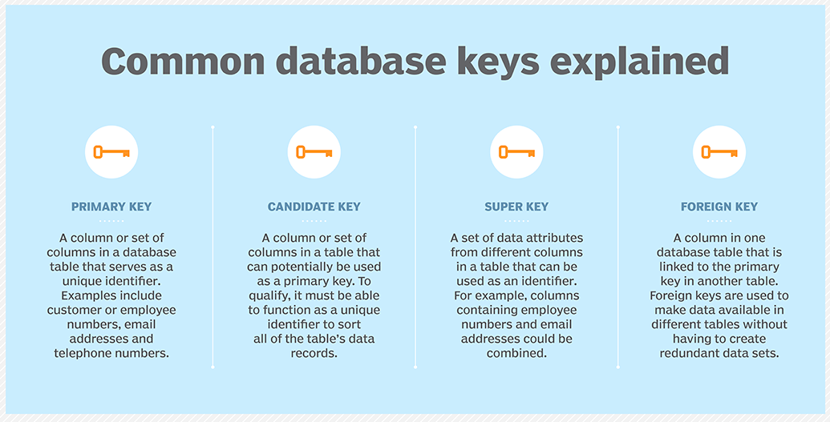
Summary

Slide 46
Thanks!!

